Slide 1
Data structures and algorithms Spring 2025
STACK AND QUEUE APPLICATIONS
Lecturer: Do Thuy Duong

Slide 2
Contents
Stack applications
Queue applications
Searching
Linear
Binary
Hash table
2

Slide 3
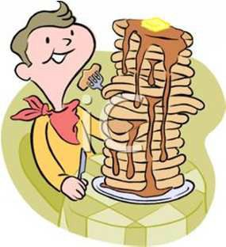
Stack Applications
3

Slide 4
Stack Applications
Application 1 - Base 10 → Base B Conversion
Application 2 - Evaluation of Postfix Expression
Application 3 - Infix expression → postfix expression
4

Slide 5
Base Conversion
Computers understand only numbers → Words and letters are translated into numbers in computer systems.
The number system is simply a system to represent or express numbers. There are various types of number systems and the most commonly used ones are decimal number system, binary number system, octal number system, and hexadecimal number system
Computer architecture supports the following number systems:
Binary number system
Octal number system
Decimal number system
Hexadecimal (Hex) number system

Slide 6
Base 10 → Base B Conversion [2]
Example: K=259 in base B=5
Answer: ?
• 259 = 2*5³+0*5²+1*5+4
• 2014₍₅₎
259
÷ 5
51 (remainder=4)
51
÷ 5
10 (remainder=1)
10
÷ 5
2 (remainder=0)
2
÷ 5
0 (remainder=2)

Slide 7
Base 10 → Base B Conversion [3]
Algorithm
Find remainder
Push found remainder to a stack
Repeat from step 1 until we meet stop condition
Pop them out to print -→ we have the result

Slide 8
Polish Expression [1]
It takes time for computer to evaluate an arithmetic expression in normal form (with parentheses)
2*(3+4)/5
((2*(3+4)+5)*6+7*8)*9
Need a mathematical notation that allows to parenthesis-free represent expressions → Polish notation:
Prefix: op arg1 arg2 / * 2 + 3 4 5
• Postfix:
arg1 arg2 op
2 3 4 + * 5 /

Slide 9
Polish Expression [2]
Postfix notation is used to reduce computer memory access and time for evaluating arithmetic expression.
Stack can be used to:
Convert an normal expression (infix expression) to postfix expression.
Evaluate a postfix expression.

Slide 10
Polish Expression [3]
Example 1
Find the correspondingpostfix & prefix notation of the following expression
(A*B)+(C/D)
A B * C D / +
+ * A B / C D
(1+3)*((2-4)+5*7)
1 3 + 2 4 - 5 7 * + *
* + 1 3 + - 2 4 * 5 7

Slide 11
Polish Expression [4]
Example 2
Evaluate the following expressions
6 2 + 3 1 - 4 * 7 + *
= 8 3 1 - 4 * 7 + *
= 8 2 4 * 7 + *
= 8 8 7 + *
= 8 15 *
= 120
− * / 15 − 7 + 1 1 3 2
= − * / 15 − 7 2 3 2
= − * / 15 5 3 2
= − * 3 3 2
= − 9 2
= 7
(6+2) * ((3-1)*4 +7)
(15 / (7-(1+1)))*3 - 2

Slide 12
Infix expression → postfix expression [1]
Define the precedence relation of some of the operators:
# is the special symbol to denote the bottom of stack.
Operators | precedence number
# | 0
( | 1
+ or - | 2
* or / | 3
14

Slide 13
Infix expression → postfix expression [2]
Examine the next element in the input
If it is an operand, output it (store for the result)
If it is left parentheses, push to stack.
If it is operator having higher priority than top, push to stack.
5. If it is operator having lower priority than top, then Pop all the operators from the stack which are greater than or equal to in precedence than that of the scanned operator. Then, push the scanned operator to the stack.
6. If closing brackets, pop operators from stack and output until an opening bracket is encountered. Pop and discard opening bracket
7. If there is more input, go to step 1
8. If no more input, pop operators to output
15

Slide 14
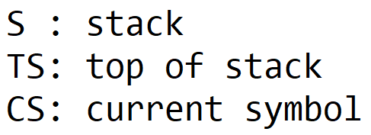
Infix expression
→ postfix expression [3]
- Scan infix expression from left to right
- If CS is operand → print(CS)
- If CS is left paren → push (S,CS)
If CS is operator:
while (prec(CS)<prec(TS))
{
op = pop(S);
print(op);
}
push(S,CS);
- If CS is right paren:
while(TS != left paren)
{
op = pop(S);
print(op);
}
discard (TS);
- If no more infix:
while (S != empty)
{
op = pop(S);
print(op);
}

Slide 15
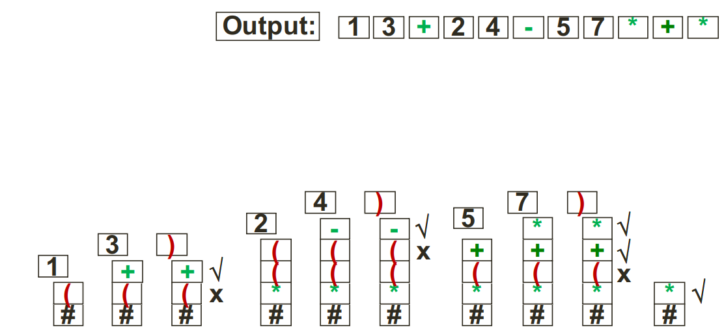
Infix expression → postfix expression [4]
(1+3)*((2-4)+5*7)

Slide 16
Evaluation of Postfix Expression [1]
Processing postfix using stack:
Scan the expression from left to right.
For each symbol, if it is an operand, we store
them for later operation (LIFO)
push
If the symbol is an operator, take out the latest 2 operands stored and compute with the operator.
pop
pop
Treat the operation result as a new operand and store it.
Finally, we can obtain the result as the only one operand stored (Top stack)
push
pop

Slide 17
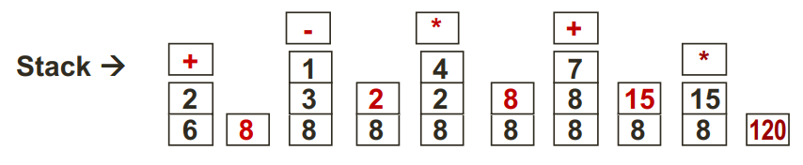
Evaluation of Postfix Expression [2]
• 6 2 + 3 1 - 4 * 7 + *
Scan the expression from left to right. 6 and 2 are operand, so we push them to the stack.
• + is an operator, pop two latest operands from stack (6 & 2), compute and push the result (8) back to stack.
Continue scanning, 3 & 1 are operand   push to stack.
- is an operator → pop → compute → push.
4 is an operand → push.
* is an operator → pop → compute → push.
7 is an operand → push.
• + is an operator → pop → compute → push.
* is an operator → pop → compute → push → final result
13

Slide 18

Queue Applications

Slide 19
Queue Applications
Application 1 – Reversing a stack
Application 2 – Message/Packet queueing
Application 3 – Job scheduling

Slide 20
Reversing a Stack
stack
//Reversing a stack
Queue q; Stack s;
while(!s.isEmpty())
{ x =s.pop();
q.enqueue(x);
}
while (!q.isEmpty())
{ x = q.dequeue();
s.push(x);
}
D C
Pop from stack and insert into a queue
B
A
queue
D C B A
A B
19
C
Delete from queue and Push onto stack
D

Slide 21
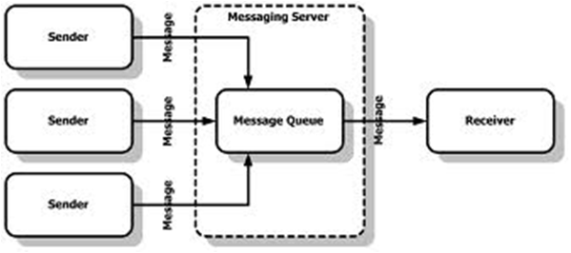
Message/Packet Queueing [1]
A queue is used to integrate messages come from different senders to receiver

Slide 22
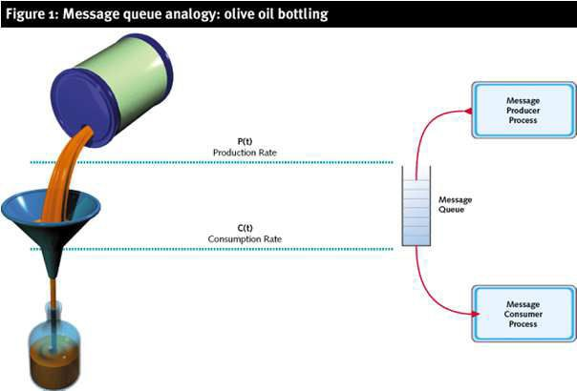
Message/Packet Queueing [2]
A queue is used to control sending and receiving rate

Slide 23
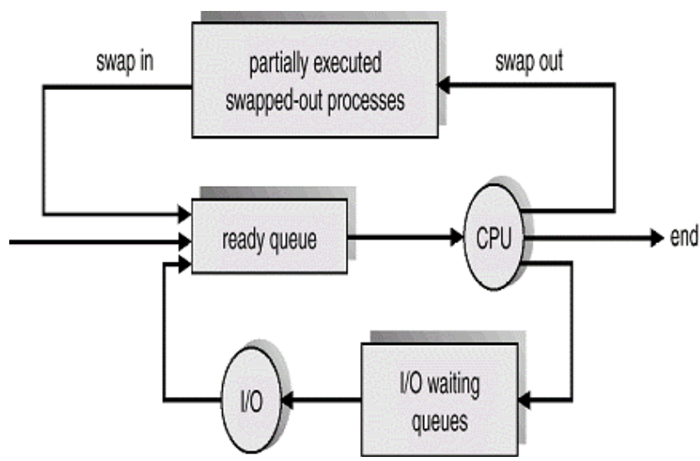
Job Scheduling

Slide 24

Search algorithms

Slide 25
Search algorithms
Definition: • A search algorithm is a method of locating a specific item of information (called key) in a larger collection of data. • This section discusses two algorithms for searching the contents of an array. • A new data structure name hash table can be used to improve the searching speed

Slide 26
Linear search algorithm [1]
• This is a very simple algorithm. • It uses a loop to sequentially step through an array, starting with the first element. • It compares each element with the value being searched for (key) and stops when that key is found or the end of the array is reached.

Slide 27
Linear search algorithm [2]
Algorithm LinearSearch(A, n, key): Input: An array A[0..n-1] storing n item. key item for searching Output: index of key in A, or -1 if not found
index ← 0 found ← false pos ← -1 while ((index < n) && (!found)) if (A[index]==key) found ← true pos ← index endif index ← index+1 endwhile return found

Slide 28
Binary search algorithm [1]
• Binary search requires the array to be in order. • The algorithm starts searching with the middle element. • If the item is less than the middle element, it starts over searching the first half of the list. • If the item is greater than the middle element, the search starts over starting with the middle element in the second half of the list. • It then continues halving the list until the item is found.

Slide 29
Binary search algorithm [2]
• Example Search 25 in 3 5 8 12 15 15 17 23 25 27 3 5 8 12 15 15 17 23 25 27 25 ? 15 15 17 23 25 27 25 ? 23 25 27 25 ? 25 It takes only 4 steps

Slide 30
Binary search algorithm [3]
Algorithm BinarySearch(A, n, key): Input: A sorted array A[0..n-1] storing n item. : key item for searching Output: index of key in A, or -1 if not found
Left ← 0 right ← n-1 while (left < right) mid (left+right)/2 if A[mid] < key left mid+1 else if A[mid] > key right mid-1 else return mid endwhile return -1

Slide 31
Binary search algorithm [4]
Algorithm BinarySearch(A, left, right, key): Input: A sorted array A[left..right]. key item for searching Output: index of key in A, or -1 if not found
if (left > right) return -1 else mid ← (left+right)/2 if A[mid] < key return BinarySearch(A,mid+1,right,key) else if A[mid] > key return BinarySearch(A,left,mid-1,key) else return mid endif

Slide 32

Binary search algorithm [5]
• Time complexity analysis: In each step we halves the input size. • Recurrence T(n)=T(n/2) + c T(n/2)=T(n/4)+c T(n)=T(n/4) + c +c T(n/4)=T(n/8)+c T(n)=T(n/8) + c + c + c ………………
T(n)=T(n/n) + c + … + c T(n)=T(1) + kc=log₂n + C
k times
→ T(n)=O(logn)

Slide 33
Linear search & Binary search
Linear search • Simple & easy to implement • Array can be in any order • Inefficient (slow) compares to binary search: O(n)
Binary search • More efficient than linear search (faster): O(logN) • Array must be sorted

Slide 34
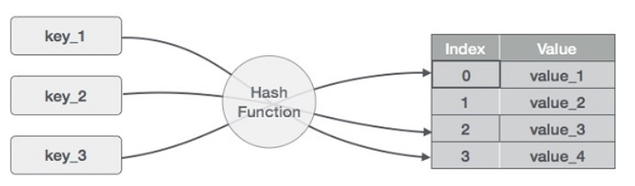
Hash table [1]
Hash Table is a data structure which stores data in an associative manner. In a hash table, data is stored in an array format, where each data value has its own unique index value. Access of data becomes very fast if we know the index of the desired data.

Slide 35
Hash table [2]
Basic Operations
Search − Searches an element in a hash table.
Insert − Inserts an element in a hash table.
Delete − Deletes an element from a hash table.
The main advantage of hash tables is speed . The access time of an element is on average O(1), therefore lookup could be performed very fast.

Slide 36
Hash table [3]
The idea:
Items are stored in the array, indexing from 0 to N-1
The address of the item in the array is determined based on the value of the key. • address = h(key) • h is called the hash function
Hash Functions
A hash function is a mathematical formula which, when applied to a key, produces a value which can be used as an index for the key in the hash table.
The main aim of a hash function is that elements should be uniformly distributed. It produces a unique set of integers within some suitable range in order to reduce the number of collisions.

Slide 37
Hash table [4]
Example: We want to create a hash data structure to maintain a list of students. For each student: • The Key is the student ID - a number has 9 digits • Data fields are student information: name, address, avatar …
We uses an array with N=100 to store 100 items from A[0] to A[99].
The hash function:
h(ID)=ID mod 100
[ 0 ] [ 1 ] [ 2 ] [ 3 ] [ 4 ] [ 5 ]
[ 99]
. . .

Slide 38



Hash table [5]
Example: address of an item
The hash function:
• h(ID)=ID % 100
• ID=506643054
Address=54
[ 54 ]
ID 506643054
Name …
[ 0 ] [ 1 ] [ 2 ] …
[99]
…..

Slide 39



Hash table [6]
Example
• ID=506642101
• ID=506645202
• ID=506648899
  Address=1
  Address=2
  Address=99
The operation maps ID (key) and address is called
hashing.
[ 0 ] [ 1 ] [ 2 ] … [ 54 ]
[ 55 ]
[99]
Number 281942902
Number 233667136
Number 506643548
. . .
Number 155778322

Slide 40

Hash table [7]
ID 506643203
Insert a new item
Perform hashing on key to find correspondingaddress.
Add item to this address.
506643203 % 100=??
[ 0 ] [ 1 ] [ 2 ] [3] [ … ] [ 54 ]
[99]
Number 281942902
Number 233667136
Number 506643548
. . .
Number 155778322

Slide 41





Hash table [8]
ID 506643203
Insert a new item
Perform hashing on key to find corresponding
Add item to this address
My hash value is [3].
] [ 99]
Number 155778322
[ 0 ] [ 1 ] [ 2 ] [99]
Number 281942902
Number 233667136

Slide 42




Hash table [9]
ID 506643402
Collisions
Collision occurs when the hashing returns an address that is already used by another valid item.
My hash value is [2].
[ 0 ] [ 1 ] [ 2 ] [ 3 ] [ 4 ] [ 5 ]
[ 700]
Number 281942902
Number 233667136
Number 580625685
Number 506643548
Number 155778322

Slide 43
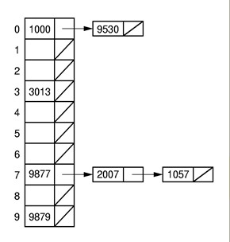
Hash table [10]
Collision handling
Two methods: Open hashing and Close hashing
Open hashing (or Separate chaining)
Each slot in the hash table is the head of a linked list.
All items that hash to a particular slot are placed on that slot's linked list.
Requires additional memory outside the table
H(k)=k % 10

Slide 44
Hash table [11]
Close hashing (or Open Addressing)
Find another slot in the hash table to store the colliding items
Probing method: If we try to place x in slot h(x) and find it occupied, find alternative location h1(x), h2(x), ... Try each in order, if all are occupied then the table is full.
Linear probing
Handle collisions by placing the colliding item in the next (circularly) available table slot.
If h(k) is occupied, probe other slot h_{i}(k) on the hash table
If h_{i}(k) is empty → store colliding item
If all h_{i}(k) are occupied → the table is full
43

Slide 45
Hash table [12]
Linear probing example
Consider a hash table of size 8 (N=8) store integer key with the hash function: h(k)=k % N = k % 8
• add(18), add(19), add(15), add(14)
• add(26)
h(26)=2 is occupied
Evaluate: h₁(26)=(h(26)+1)%8=3 is occupied
0
1
2
3
4
5
6
7
38
18
19
26
14
15
Evaluate: h₂(26)=(h(26)+2)%8=4 is empty → stores 26 at 4.
• add(38)
44

Slide 46
Tutorial & next topic
Preparing for the tutorial (at home):
Practice with examples and exercises in Tutorial 7.
Preparing for the midterm test
Preparing for next topic:
Read textbook chapter 4 (4.1 – 4.3): Tree data structure.
Read supplementary book chapter 10 (10.4) and chapter 12
45

